Slide 1
The HKEX Digital Design System
William Ng
UX UI Designer HKEX

Slide 2
Purpose of the meeting
Aware of the existence of the system
Contribute to the system

Slide 3
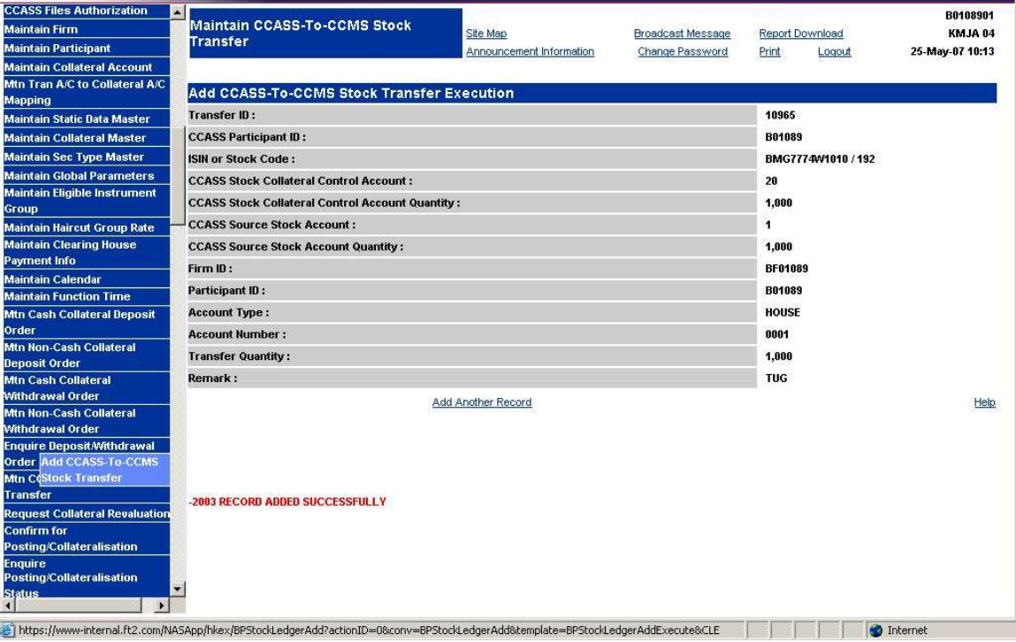
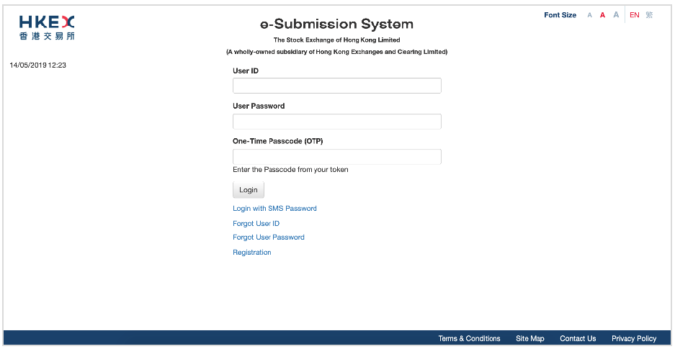
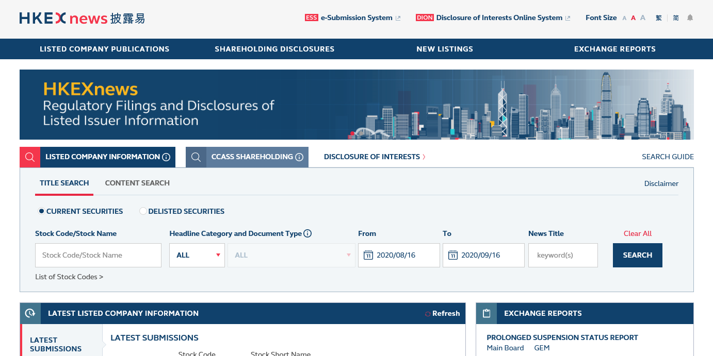
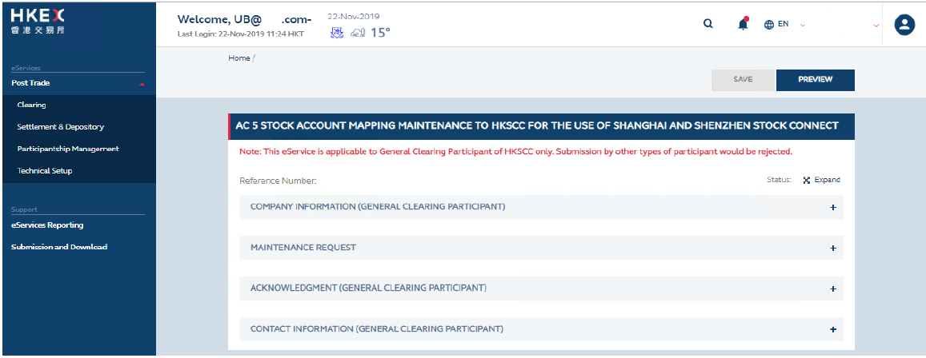
Customer Facing Systems
E-Submission System
CCASS
Client Connect
HKEX news
Approx. 19 in total

Slide 4
Introduction of the Design System
The Design System is essentially a centralized, standardized, and reusable collection of user interface components (buttons, inputs etc.) visual styles, usage guidelines, and code at is all aligned.
The system should be followed when building a business applications, so that our users can have a consistent experience when using our products.

Slide 5
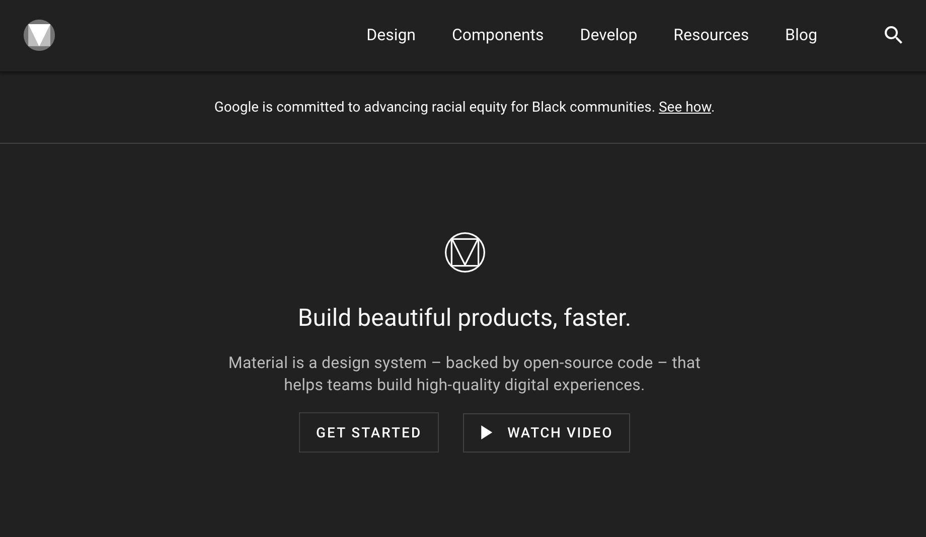
Material Design

Slide 6
Material Design
Material Design is a design system by Google to help teams build high-quality digital experience for Android, iOS, Flutter and the web.
https://material.io/

Slide 7
UI Inventory
–––––

Slide 8

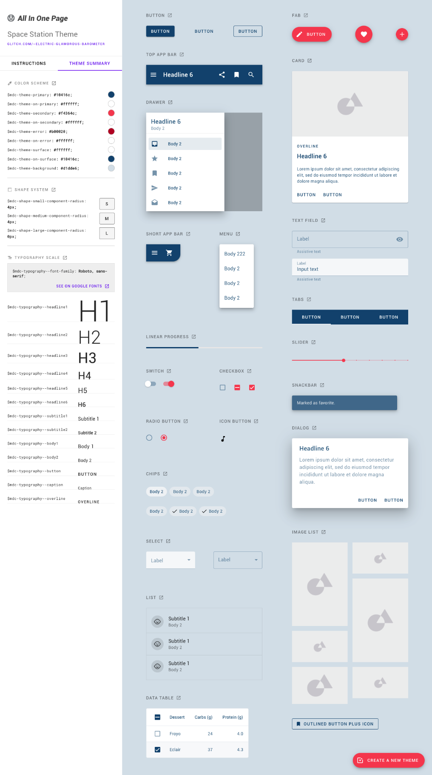
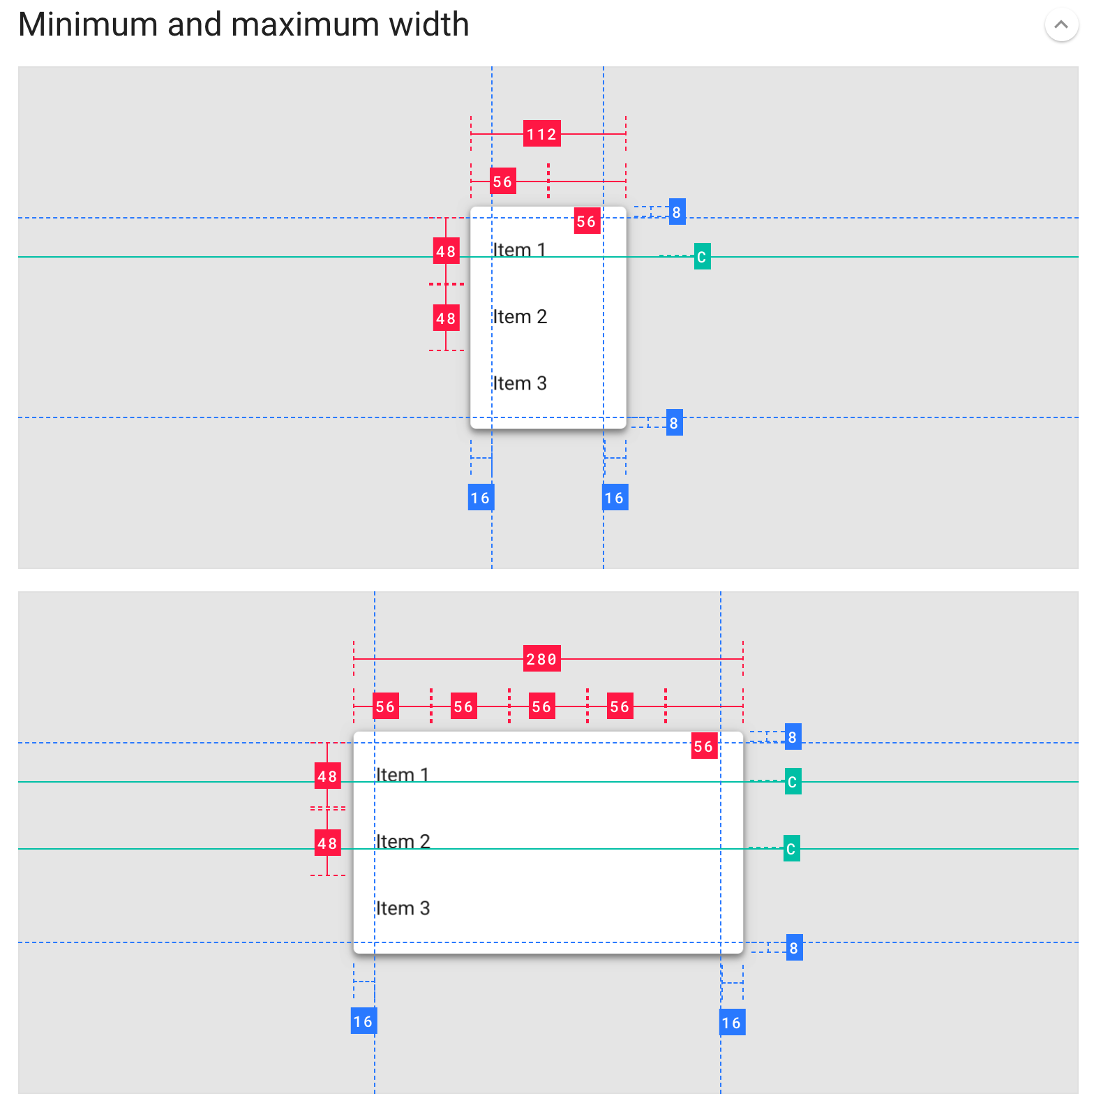
HKEX Themed Web Components

Slide 9
Demo the web components
https://electric-glamorous-barometer.glitch.me/

Slide 10
Artifacts
–––––

Slide 11


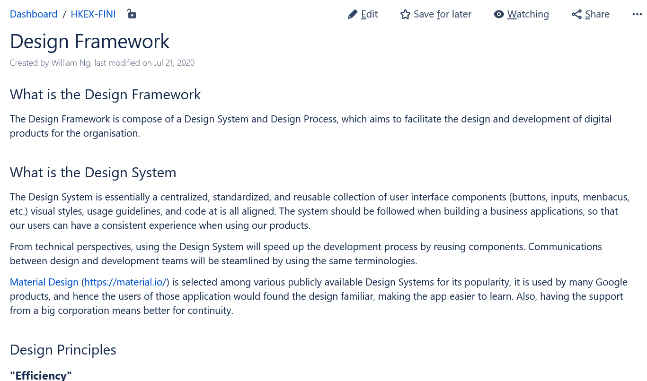
Whats in each file?
iExchange
HTML
HKEX Digital
Design System
Page
Sample
Wireframe
HKEX
Axure Library
One pager about the HKEX Digital Design System, with instructions and links.

Slide 12
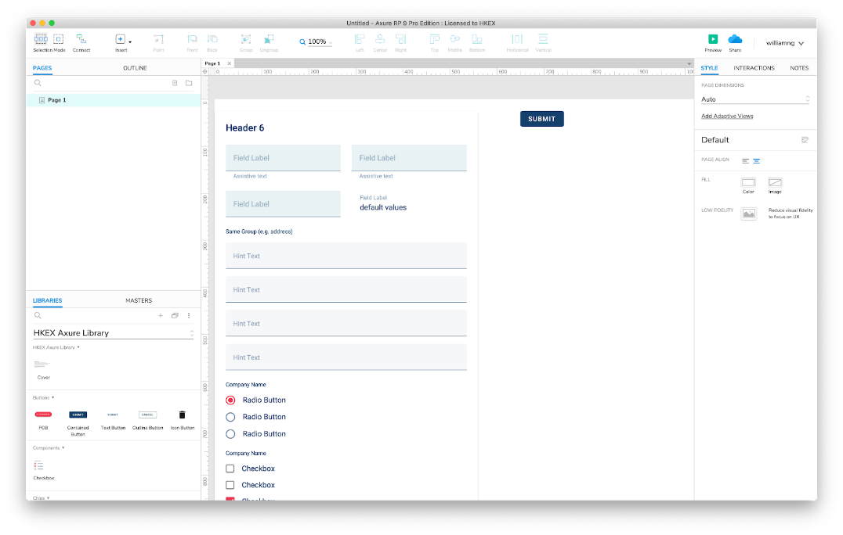
Whats in each file?
iExchange
HTML
HKEX Digital
Design System
Page
Sample
Wireframe
HKEX
Axure Library
Sample wireframe.
With page structure, sample cover page, templates..

Slide 13
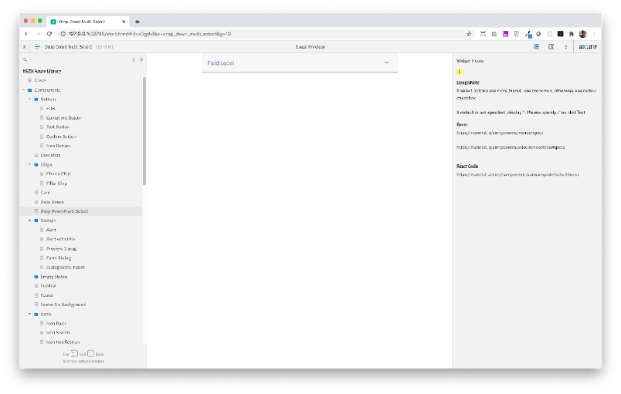

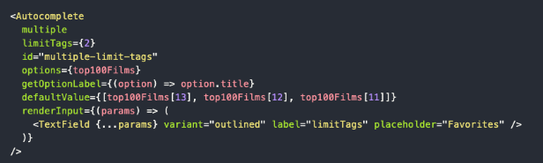
Whats in each file?
iExchange
HTML
HKEX Digital
Design System
Page
Sample
Wireframe
HKEX
Axure Library
Component Library
With links to corresponding visual specification and code.

Slide 14
Demo the use of the library for Vendor Designers and Developers

Slide 15
Work Flow
–––––

Slide 16
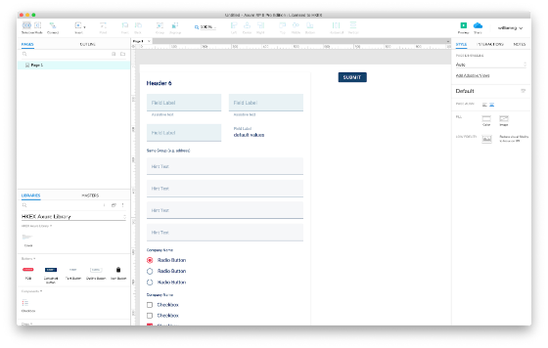
Use as the base for multiple projects
iExchange
HTML
HKEX Digital
Design System
Page
Sample
Wireframe
HKEX
Axure Library
Via Email
Project Team
Project Team
Design Vendor

Slide 17
Create wireframes with the Axure Library
Project Team
or
Design Vendor
Axure RP software to be installed on local machine

Slide 18
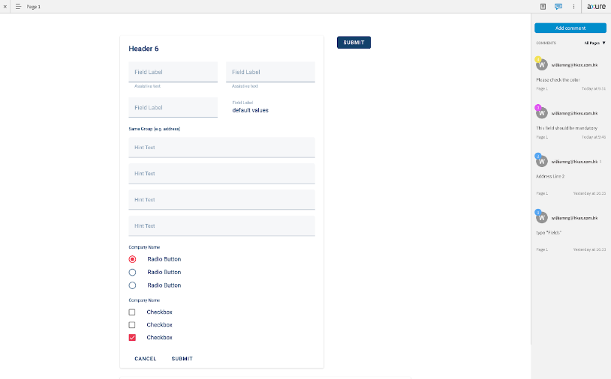
Publish to AxShare (Axure’s Cloud for wireframe sharing)
AxShare
e.g. https://y7lxkm.axshare.com
Project Team
or
Design Vendor
Publish
Wireframe

Slide 19
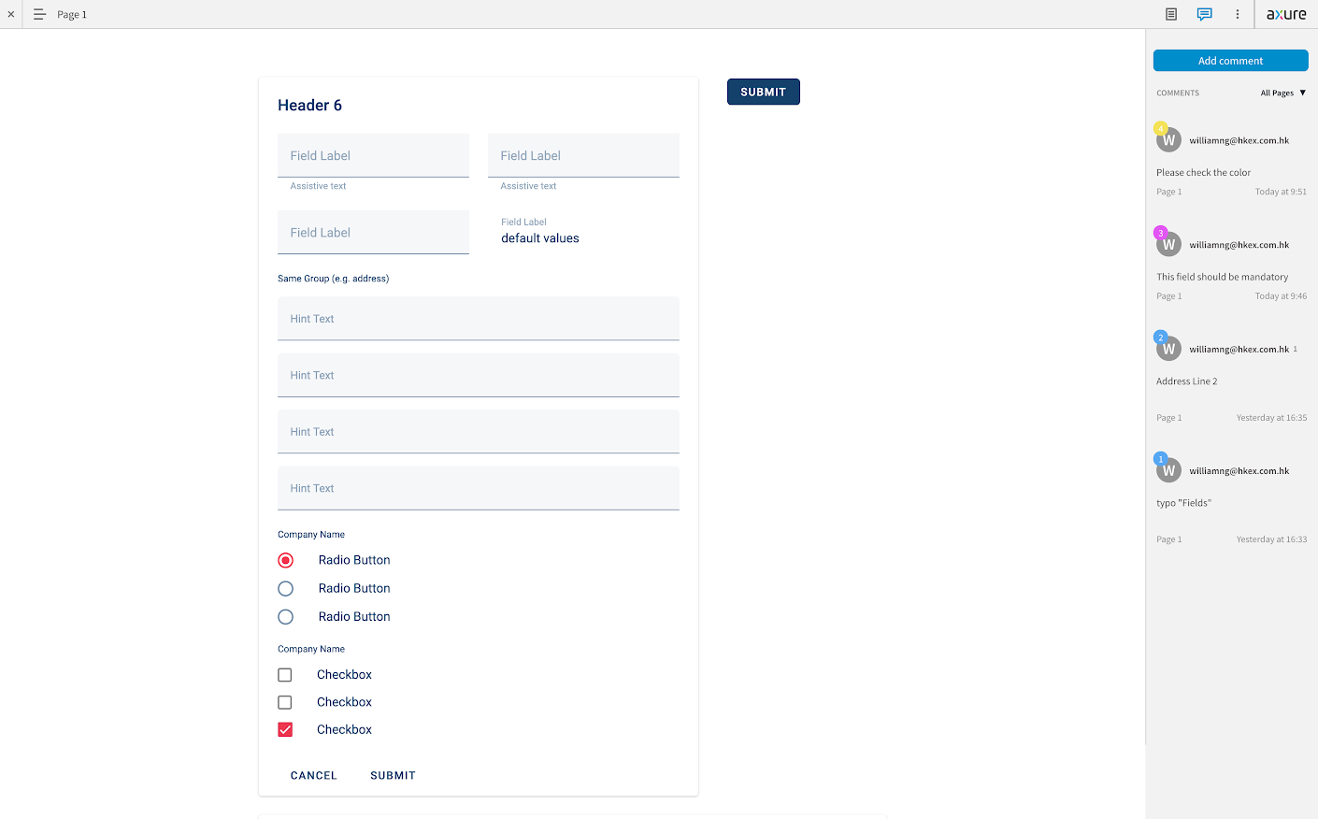
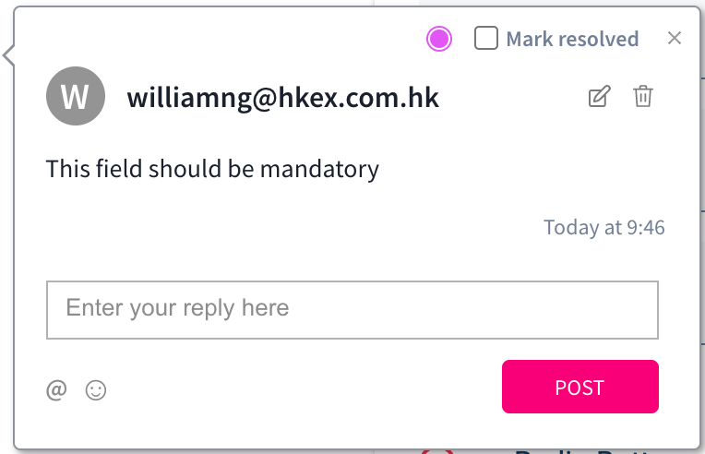
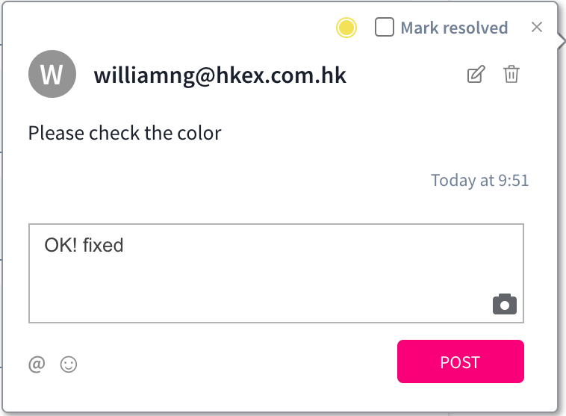
Collaborate and revise
AxShare
e.g. https://y7lxkm.axshare.com
Business User
Project Team
business@hkex.com.hk
design@hkex.com.hk
Design Vendor
Other Stakeholders
Pinpoint to a specific element for the discussion.

Slide 20
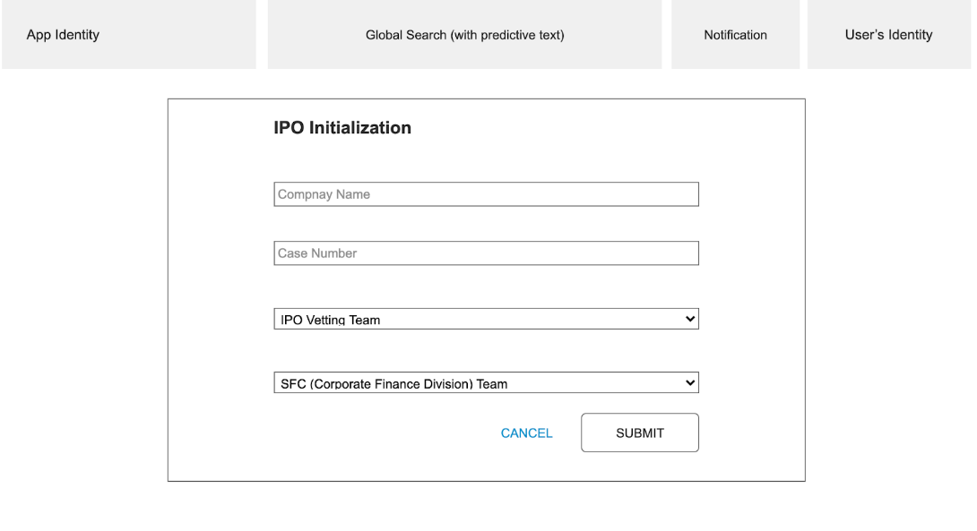
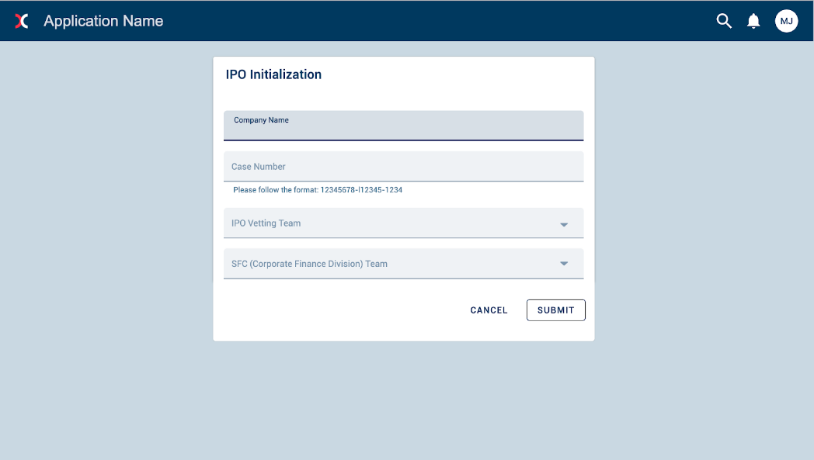
Produce Hi Fi Mockups

Slide 21
Mockup Showcase
–––––

Slide 22
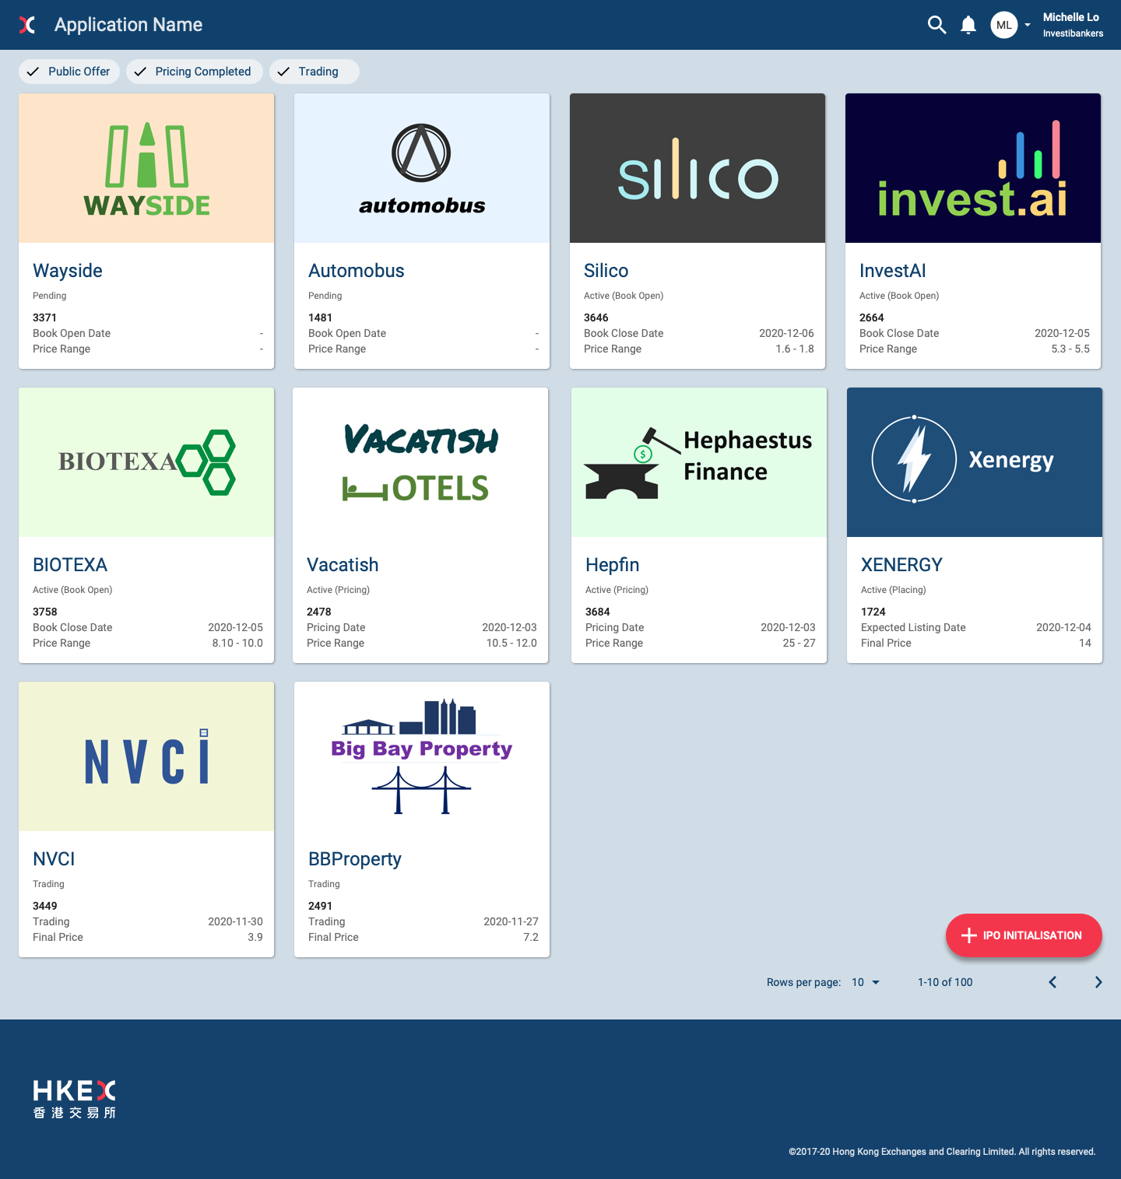
Cards

Slide 23
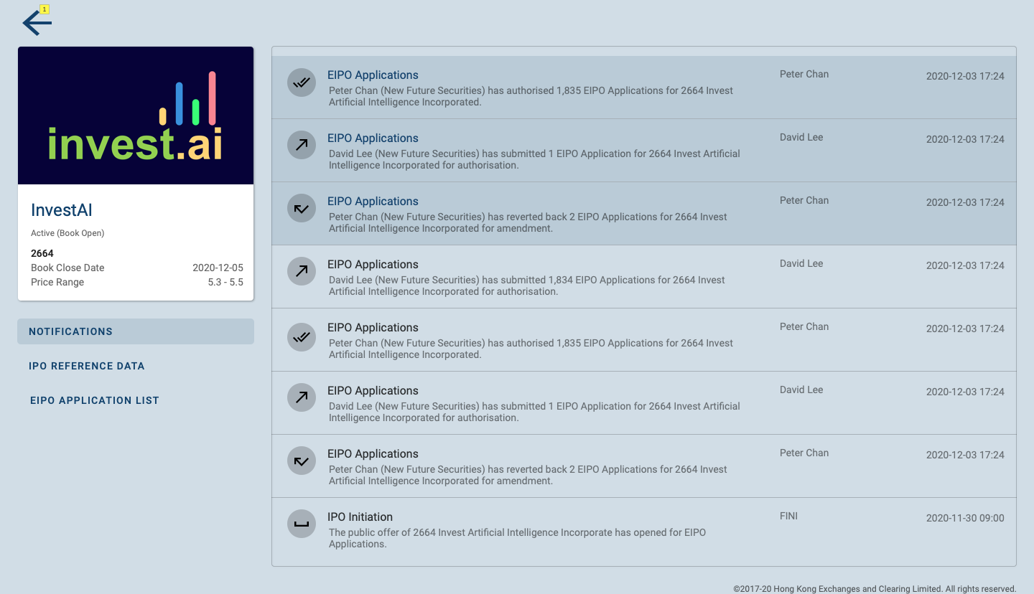
List

Slide 24
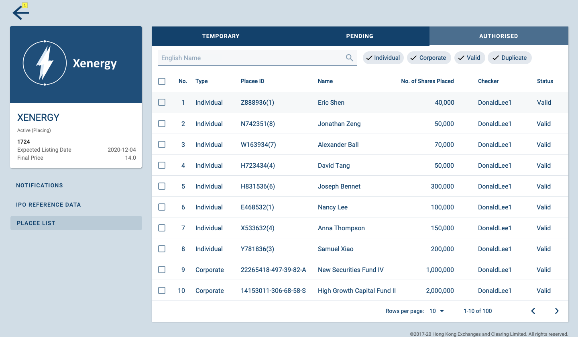
Data Table and Tabs

Slide 25
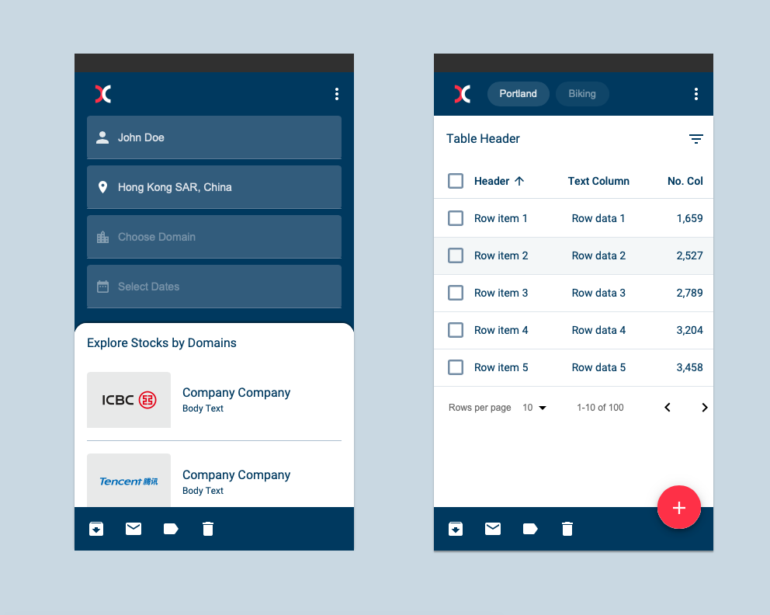
Mobile

Slide 26
Compatibility
–––––

Slide 27
Frontend Development Frameworks
React
(Material UI)
Angular
(Material Angular)
Android
(Material.io)
HKEX Digital Design System
Implemented by
Vue
(Vue Material)
Web
(Material.io)
iOS
(Material.io)

Slide 28


Other Design Systems
Ant Design
HKEX Digital Design System
Blue Print
Typography
Colours
Grid System
…etc
Logo Usage
Header Footer
Component Rules

Slide 29
Comments or Questions?

